Slide 1

Presentation Title
Group Name:

Slide 2



Agenda
Introduction – (what is this all about)
Getting Started – (what research did you do)
Interview Description – (who was the user, what are their needs)
Selection – (explain a few considerations)
Justification – (why does this fit the users needs)

Slide 3
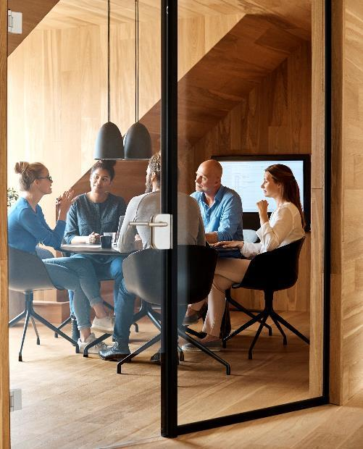



Introduction
We interviewed Rey about what type of pc he would like. We also asked what his plans are and how he would use the pc most of the time. We were told that he would mainly use his pc for gaming. The main games he would play are apex legends and call of duty. These games would need decent CPU and GPU's to run. Rey would also sometimes watch Netflix or Disney on his PC.

Slide 4

Getting Started
Some of the research that we had to do were the components that are found inside computers such as the RAM, CPU and GPU. We learned what the object was of each component such as the Ram is the Random-access memory and that it makes a copy of the system then saves the changes later when you are done. We also researched different pre-built computers and the price points of them.

Slide 5
Interview Description
In order to for the pc to run the games requested by Rey the pc would need at least 8GB of RAM, Intel Core i5-2500K or AMD Ryzen 3 1200 for the CPU. The GPU would require NVIDIA GeForce GTX 960 or AMD Radeon RX 470 and at least 2 GB of video memory. Apex would require at least 22 GB of storage while Call of duty warzone would require 22.6 GB on steam.

Slide 6
Selection
On PB tech I found a PC perfect for Reys needs; it costs $998.99.Its name is GPC RX 6400 Gaming PC AMD Ryzen 3 4100 4 Core - 256GB SSD - 8GB RAM - AMD Radeon RX6400 4GB.

Slide 7
Justification
The reason I had chosen the GPC RX 6400 Gaming PC is because it fits many of the requirements that Rey has set when asking for a pc. Its price is within his price point while also having the system requirements that the chosen games would require such as the GB of RAM and the Ryzen 3 4100 4 Core. There will also be enough space to upgrade the PC if Rey would like because there is 3 unused ram slots and Rey can also replace some of the components if he wants to

Slide 8

Summary
This PC that I have chosen is perfect for Reys need as it can run the games he required. It is in his requested price point for his PC.

Slide 9


Thank You
Presenter name
Email address
Website address

Slide 10




Team
Name
Name
Name
Name
Title
Title
Title
Title

Slide 11
Chart

Slide 12
Table
 | Category 1 | Category 2 | Category 3 | Category 4
Item 1 | 4.5 | 2.3 | 1.7 | 5
Item 2 | 3.2 | 5.1 | 4.4 | 3
Item 3 | 2.1 | 1.7 | 2.5 | 2.8
Item 4 | 4.5 | 2.2 | 1.7 | 7

Slide 13

The way to get started is to quit talking and begin doing.
Walt Disney

Slide 14
Timeline
Title
To start a presentation, go to the Slide Show tab, and select From Beginning.
Title
To display Presenter view, in Slide Show view, on the control bar at the bottom left select the three dots, and then Show Presenter View.
Title
During your presentation, the speaker notes are visible on your monitor, but aren't visible to the audience.
Title
Title
If you don’t see the Notes pane or it is completely minimized, click Notes on the task bar across the bottom of the PowerPoint window.
The Notes pane is a box that appears below each slide. Tap it to add notes.

Slide 15
Content
Subtitle
Subtitle
Add text, images, art, and videos.
Add transitions, animations, and motion.
Save to OneDrive, to get to your presentations from your computer, tablet, or phone.
Open the Design Ideas pane for instant slide makeovers.
When we have design ideas, we’ll show them to you right there.

Slide 16
Content 2
Subtitle
subtitle
subtitle
Add text, images, art, and videos.
Add transitions, animations, and motion.
Save to OneDrive, to get to your presentations from your computer, tablet, or phone.
Open the Design Ideas pane for instant slide makeovers.
When we have design ideas, we’ll show them to you right there.
Add text, images, art, and videos.
Add transitions, animations, and motion.
Save to OneDrive, to get to your presentations from your computer, tablet, or phone.
Open the Design Ideas pane for instant slide makeovers.
When we have design ideas, we’ll show them to you right there.
Add text, images, art, and videos.
Add transitions, animations, and motion.
Save to OneDrive, to get to your presentations from your computer, tablet, or phone.
Open the Design Ideas pane for instant slide makeovers.
When we have design ideas, we’ll show them to you right there.

